Slide 1
Introduction Computer Vision (CS641)
Lecture02 - Working with Images
Dr. Abdul Basit
Assistant Professor - CSIT University of Balochistan
May 15, 2024
Dr. Abdul Basit (CSIT - UoB) Introduction to Computer Vision - Working with Images

Slide 2



Contents
Image Basics
Image noise
OpenCV functions
Dr. Abdul Basit (CSIT - UoB) Introduction to Computer Vision - Working with Images

Slide 3
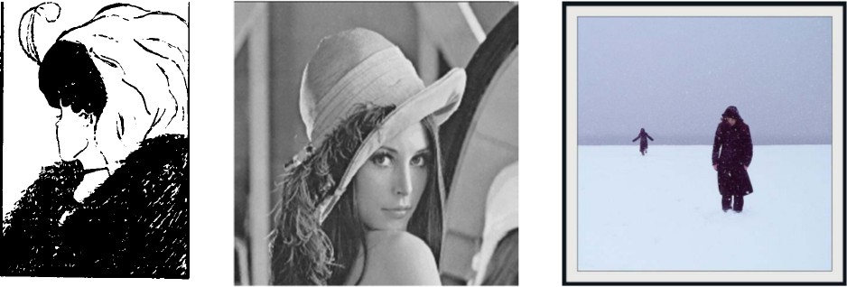
Image basics
Image types
Binary Gray Scale Color
Figure: Image samples. Binary, Gray scale and color.
Dr. Abdul Basit (CSIT - UoB) Introduction to Computer Vision - Working with Images

Slide 4
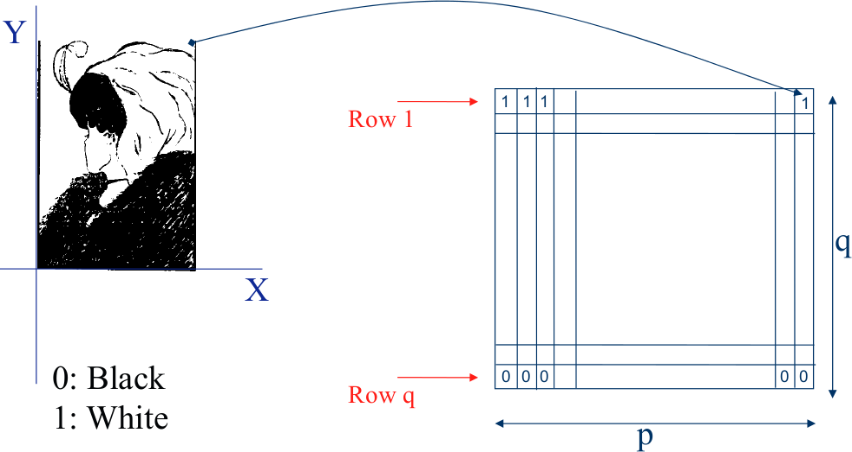
Image basics
Binary Images
Figure: Binary Images.
Dr. Abdul Basit (CSIT - UoB) Introduction to Computer Vision - Working with Images

Slide 5
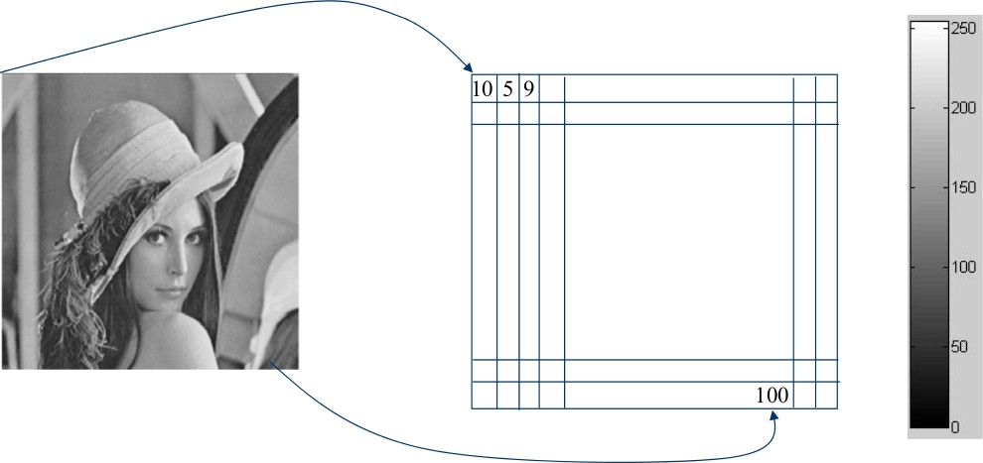
Image basics
Gray Level Images
Grayscale is a range of shades of gray from 0 to 255 without apparent color.
Figure: Gray Level Images.
Dr. Abdul Basit (CSIT - UoB) Introduction to Computer Vision - Working with Images

Slide 6
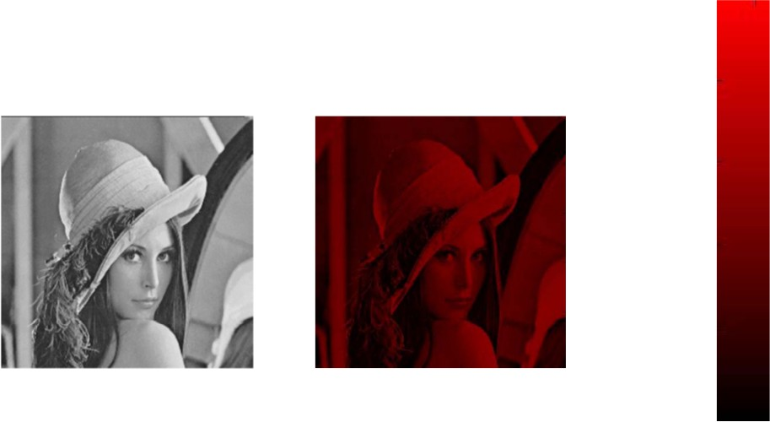
Image basics
Gray Level Images
Adding a red color channel to the grayscale image.
Figure: Gray Level Images with color channel.
Dr. Abdul Basit (CSIT - UoB) Introduction to Computer Vision - Working with Images
6 / 18

Slide 7
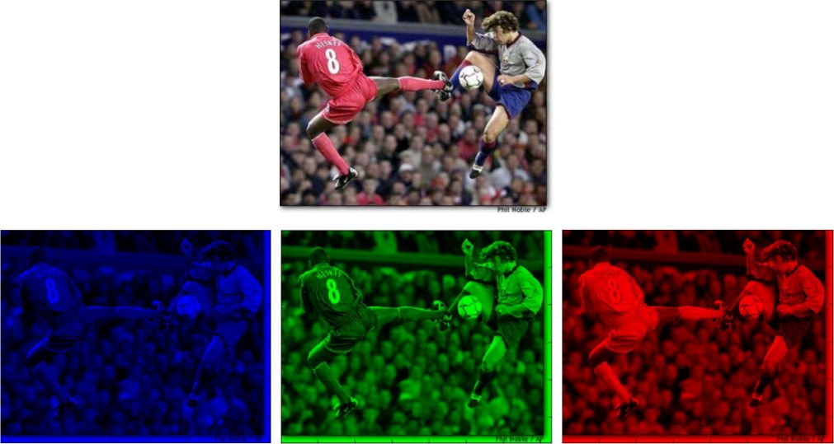
Image basics
Color Images
Color images consists of red, green and blue channels.
Figure: Color Images.
Dr. Abdul Basit (CSIT - UoB) Introduction to Computer Vision - Working with Images

Slide 8
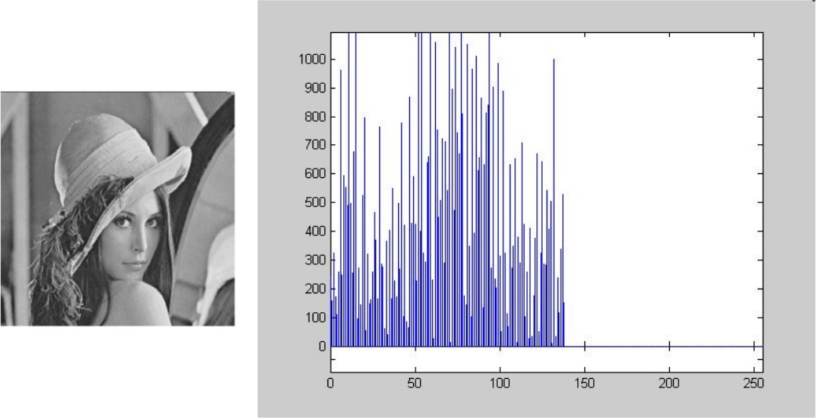
Image Histogram
An image histogram is a graphical representation of the number of pixels in an image as a function of their intensity.
Histograms are made up of bins, each bin representing a certain intensity value range.
Figure: Image histogram.
Dr. Abdul Basit (CSIT - UoB) Introduction to Computer Vision - Working with Images

Slide 9


Contents
Image Basics
Image noise
OpenCV functions
Dr. Abdul Basit (CSIT - UoB) Introduction to Computer Vision - Working with Images

Slide 10
Image Noise
The noise added to the image changes the actual pixel intensity value. The reasons of noise in image
Light variations Camera electronics Surface reflectance Lens
Dr. Abdul Basit (CSIT - UoB) Introduction to Computer Vision - Working with Images

Slide 11
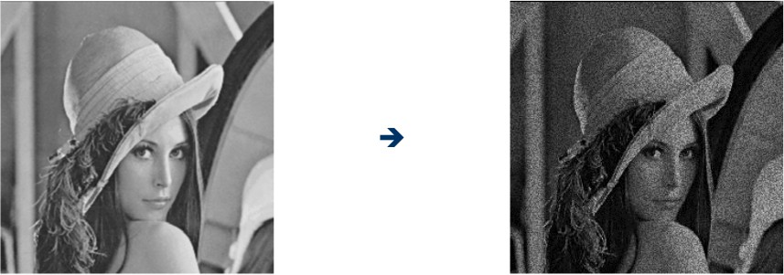
Image noise
I (x, y ): the true pixel values
n(x, y ): the noise at pixel (x, y )
^{ˆ}I (x, y ) = I (x, y ) + n(x, y )
Figure: Noise added to the image.
Dr. Abdul Basit (CSIT - UoB) Introduction to Computer Vision - Working with Images

Slide 12
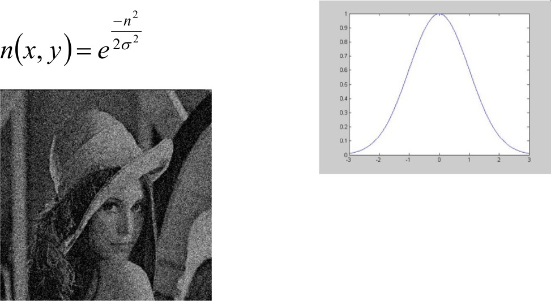
Image noise
Gaussian noise
A function that represents the distribution of a variable (random variables) as a symmetrical bell-shaped graph.
Dr. Abdul Basit (CSIT - UoB) Introduction to Computer Vision - Working with Images
Figure: Gaussian Noise.

Slide 13

Contents
Image Basics
Image noise
OpenCV functions
Dr. Abdul Basit (CSIT - UoB) Introduction to Computer Vision - Working with Images

Slide 14
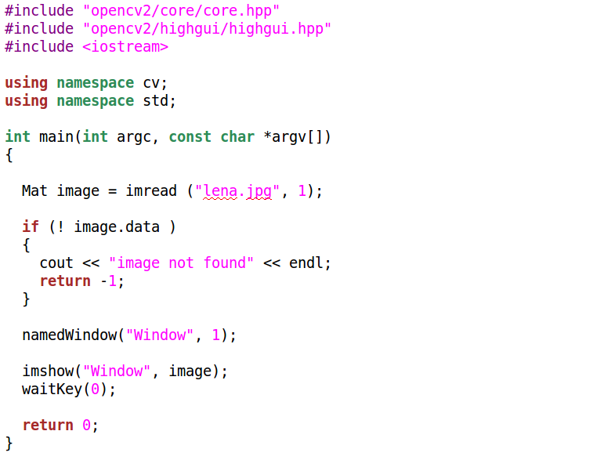
A sample program
Dr. Abdul Basit (CSIT - UoB) Introduction to Computer Vision - Working with Images

Slide 15
OpenCV functions
Grayscale image
cvtColor(src, dst, CV BGR2GRAY);
Thresholding to binary
#include ”opencv2/imgproc/imgproc.hpp”
threshold (src gray, dst bin, 120, 255, THRESH BINARY);
Dr. Abdul Basit (CSIT - UoB) Introduction to Computer Vision - Working with Images

Slide 16
OpenCV functions
filter
Create your own box filter
kernel = Mat::ones( 3, 3, CV 32F ) / 9; filter2D(src, dst, ddepth , kernel, anchor, delta, BORDER DEFAULT );
Dr. Abdul Basit (CSIT - UoB) Introduction to Computer Vision - Working with Images

Slide 17
OpenCV functions
Smoothing images
Block filter
blur( src, dst, Size( i, i ), Point(-1,-1));
Gaussian filter
GaussianBlur( src, dst, Size( i, i ), 0, 0 );
Median filter
medianBlur ( src, dst, i );
Dr. Abdul Basit (CSIT - UoB) Introduction to Computer Vision - Working with Images

Slide 18
Next class - Edge Detection
Dr. Abdul Basit (CSIT - UoB) Introduction to Computer Vision - Working with Images

